Slide 1
CATERPILLAR HACKATHON · SMART OPERATOR ASSISTANT
COPS
Caterpillar Operator Protection System
An AI co-pilot that protects the machine operator before, during and after every shift.
[Team name] · [Hackathon name] · [Date]

Slide 2
THE CHALLENGE
Machines got smart. The operator's tools didn't.
Today on site
What the brief asks for
Excavators and loaders are increasingly digital, yet operators still work with paper checklists, fixed time estimates, a seatbelt chime and no live safety support.
Daily task dashboard
Real-time safety: seatbelt, proximity, incidents, working conditions
Operator training hub
Detection of unusual behaviour (idling, unsafe patterns)
Task time estimation from past data and conditions
COPS · Caterpillar Operator Protection System · Project overview
02
Notes:
The brief: build a multi-functional operator interface, an intelligent companion, not just a tool. Five expected outcomes on the right.

Slide 3
OUR ANSWER
One co-pilot for the whole shift
Before work
During work
When it goes wrong
After work
Punch-in by operator ID
Walkaround checklist
Weather-smart plan
No seatbelt, no engine start
Live safety score
Proximity & fatigue AI
Live machine health
Hands-free voice (EN / Hindi)
Two-level SOS
WhatsApp + SMS to supervisor
Emergency machine stop
Black-box recorder
Shift report
Handover briefing
Coaching & training
Model retrains itself
COPS · Caterpillar Operator Protection System · Project overview
03
Notes:
COPS covers the operator's full shift: before, during, when things go wrong, and after. The colours go from steel gray to CAT yellow, our heritage theme.

Slide 4

THE CLOSED LOOP
Every shift makes the next one safer
Measure
Detect
Coach
Train
Improve
Telemetry + live shift events
AI flags idling & unsafe patterns
Tips and goals from your own data
Micro-lessons, XP, skill level
Scores rise, predictions adapt
Example: seatbelt alerts in Raju's telemetry → the seatbelt lesson is recommended → he passes the quiz → XP and skill rise → his task-time predictions and safety score update.
COPS · Caterpillar Operator Protection System · Project overview
04
Notes:
This loop is what makes COPS one system rather than separate features. Every module feeds the next.

Slide 5

ARCHITECTURE
Three layers, AI running in the cab
In the cab (browser)
COPS API (FastAPI)
Data & connections
React 18 + Vite interface
TensorFlow.js person detection
MediaPipe fatigue tracking
Web Speech voice in/out
three.js 3D digital twin
ML: task time + anomalies
Weather-aware scheduler
Shift, handover, performance
Machine-health model
SOS, alerts, shift report
Telemetry & task history
Live shift state
WhatsApp / SMS gateway
Claude API (optional)
Fusion 360 model (FBX)
COPS · Caterpillar Operator Protection System · Project overview
05
Notes:
Camera AI runs in the browser, so video never leaves the cab. The API holds the ML models and business logic.

Slide 6
TECH STACK
What we built it with, and why
Layer | Technology | Used for
Frontend | React 18, Vite 5, Recharts | Operator cockpit, 9 tabs, charts
3D | three.js (FBX / GLB loaders) | Live digital twin of the Fusion 360 model
Vision AI | TensorFlow.js + COCO-SSD | Person detection and distance zones
Vision AI | MediaPipe Face Landmarker | Eye closure, yawns, PERCLOS
Voice & audio | Web Speech API, Web Audio | Hands-free commands, spoken alerts, sirens
Backend | Python 3.11, FastAPI, Uvicorn | REST API, shift state, alerts
Machine learning | scikit-learn, pandas, NumPy | Gradient boosting, IsolationForest
AI assistant | Claude API + offline rule engine | Ask COPS answers about shift and machine
Alerts | WhatsApp / SMS gateways | SOS, idle and stop alerts to the supervisor
CAD | Autodesk Fusion 360 (Python API) | Twin-ready excavator, FBX export
COPS · Caterpillar Operator Protection System · Project overview
06
Notes:
Everything is open-source or a browser standard, except the optional Claude API and SMS gateways.

Slide 7
THE AI INSIDE
Every model explains itself
Model | Job | How we keep it honest
Gradient boosting (quantile) | Task time + 80% range | ~5× more accurate than static estimates
IsolationForest + rules | Unusual idling, unsafe patterns | Every flag states its reason
COCO-SSD (TensorFlow.js) | People behind the machine | In-browser; distance calibrated
MediaPipe Face Landmarker | Microsleep, drowsiness, yawns | Video never leaves the cab
Weather-aware search | Order tasks around rain, wind | Tries 120 orders, explains moves
Rule-based language parser | Speech → incident report | Offline; operator reviews fields
Trend & leak detection | Fluids and temperatures | Predicts time until critical
Claude (optional) | Ask COPS assistant | Falls back to offline answers
COPS · Caterpillar Operator Protection System · Project overview
07
Notes:
Prediction figures are on our calibrated demo data. Every AI output in the app also shows a confidence percentage with its basis and limits.

Slide 8
FEATURE MAP
15 modules, one system
Punch-in & handover
Smart schedule
Engine interlock
Live safety score
Proximity AI
Spoken briefing for the next operator
Plans around rain and wind
No seatbelt, no engine start
Changes every second of work
Danger zones and voice STOP
Fatigue AI
Two-level SOS
Supervisor alerts
Machine health
Digital twin
Microsleep and yawn detection
Manageable or high-risk, auto-escalates
WhatsApp and SMS
Leak and overheat prediction
Fusion 360 model, live
Voice incidents
Insights
Shift report
Training hub
Ask COPS
One sentence, full report
Idle cost in ₹ and CO₂
One page, sent on WhatsApp
Lessons from your own data
AI assistant, works offline
COPS · Caterpillar Operator Protection System · Project overview
08
Notes:
The full list of 97 features is in the third deck. Here are the 15 modules.

Slide 9
SAFETY INTERLOCKS
Unsafe? The machine won't move
Trigger | Immediate response | Escalation
Seatbelt off at engine start | Start blocked, siren, red banner | Logged against the safety score
Seatbelt removed while running | Siren at once, repeats every 2 s | Final warning 8 s → supervisor 16 s
Person closer than 3 m | Voice STOP, motion inhibited | Near-miss logged, black box saved
Operator drowsy or microsleep | Alarm, new tasks blocked | Emergency stop, supervisor alerted
Critical machine fault | Siren and the action to take | Emergency stop, WhatsApp + SMS
Engine idling with no work | Banner with fuel wasted in ₹ | WhatsApp to the supervisor
Meanwhile the live safety score drains every second an unsafe condition lasts, and recovers during clean work.
COPS · Caterpillar Operator Protection System · Project overview
09

Slide 10


EMERGENCIES
Two-level SOS with automatic escalation
High risk: injury, fire, rollover, person trapped, utility strike
Operator taps SOS
WhatsApp + SMS to supervisor at once
Emergency stop + black box saved
Supervisor acknowledges → resolves
Manageable: breakdown, stuck in mud, minor fault, top-up
Operator taps SOS
Guided fix, no alert yet
Not solved in 60 s?
Escalates to high risk
Each message carries the machine, operator, time, location with a map link, the action to take and the events just before.
COPS · Caterpillar Operator Protection System · Project overview
10
Notes:
Manageable problems don't flood the supervisor, but nothing is lost: if the operator can't fix it within 60 seconds, it escalates automatically.

Slide 11
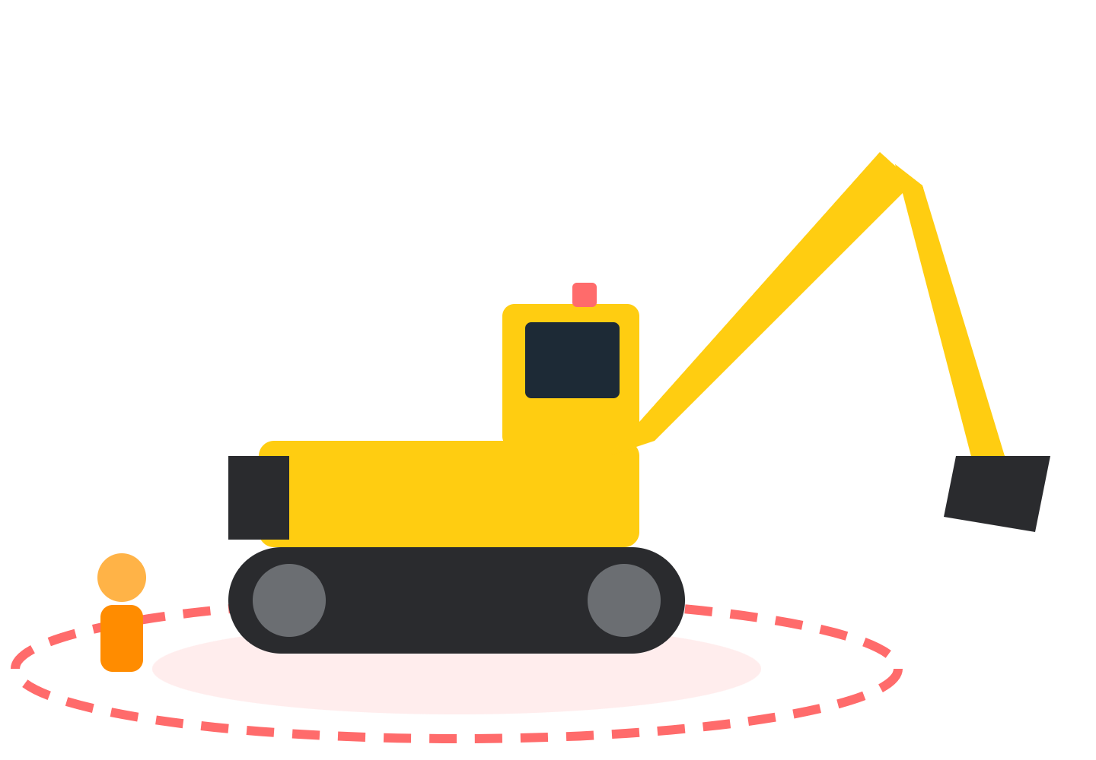
DIGITAL TWIN
Designed in Fusion 360, running on live data
A Fusion 360 script builds the excavator with nested parts and pivots on the real pins
Exported as FBX, loaded live with three.js
Digs while a task runs, freezes on any interlock
Shows the worker and danger rings the camera sees
3D walkaround hotspots, engine glow when idling
Paint shifts gray → CAT yellow as skill grows
COPS · Caterpillar Operator Protection System · Project overview
11
Notes:
The same CAD model engineers design with becomes the live view of the machine: design and operation connected.

Slide 12
BY THE NUMBERS
What COPS delivers
5×
97
0
16/16
more accurate task times than static site estimates
features across 16 areas
video frames leave the cab: camera AI runs on-device
automated backend checks passing
COPS · Caterpillar Operator Protection System · Project overview
12
Notes:
Accuracy is measured on held-out tasks in our calibrated demo data.

Slide 13
NOVELTY
What typical operator apps do, and what COPS does
 | Typical operator app | COPS
Safety score | Static, end of the week | Live, every second the engine runs
Seatbelt | Reminder chime | Engine interlock + escalation to supervisor
AI output | An unexplained number | Explanation + confidence % on every result
Emergencies | One panic button | Two-level SOS, auto-escalation, WhatsApp
Shift change | Verbal handover | Spoken briefing, re-planned for the new operator
Machine view | 2D dashboard | Live 3D twin from the Fusion 360 CAD model
Connectivity | Cloud only | Core AI runs offline in the cab
Language | English only | Voice in English and Hindi
COPS · Caterpillar Operator Protection System · Project overview
13

Slide 14
RESPONSIBLE AI
Trust is designed in, not added later
Explainable
Honest confidence
Private by design
Every prediction has a Why? breakdown: base time, weather, skill, machine age. Every anomaly states its reason.
An AI % badge on every AI result shows the method, the evidence and the limitations. Capped at 95%: never certain.
Camera AI runs on the device. No video is stored or sent. Reporting an incident never lowers your score.
Data note: the brief supplied 9 sample rows. We generated about 900 synthetic tasks and 170 telemetry windows calibrated to reproduce them, and we say so openly.
COPS · Caterpillar Operator Protection System · Project overview
14

Slide 15
ROADMAP
From hackathon prototype to site pilot
Connect
Protect
Scale
Live telemetry from Cat Product Link / VisionLink
Real seatbelt and seat sensors via the machine bus
GPS geofences for overhead power lines
Seatbelt-bypass detection with the cab camera
Wearables for heart rate and heat stress
Offline-first app with background sync
More Indian languages and an icon-only mode
Fleet-wide supervisor analytics
COPS · Caterpillar Operator Protection System · Project overview
15

Slide 16
COPS
Protecting the operator at every step of the shift.
Before the engine starts · while they work · when things go wrong · after the shift
Thank you · [Team name] · [Contact]

